Slide 1


DPABI: Statistical Analysis and Results Viewing
严超赣
Chao-Gan Yan, Ph.D.
yancg@psych.ac.cn
http://rfmri.org/yan
Institute of Psychology, Chinese Academy of Sciences

Slide 2
Outline
Statistical Analysis
Results Viewing
2

Slide 3


Slide 4
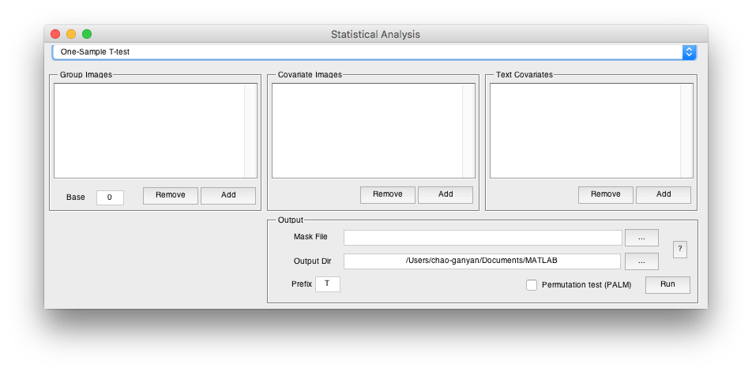
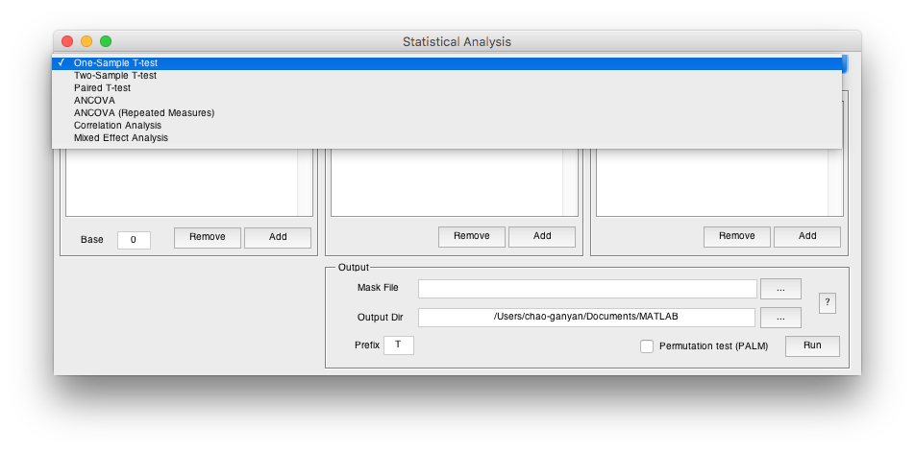
Statistical Analysis
4

Slide 5
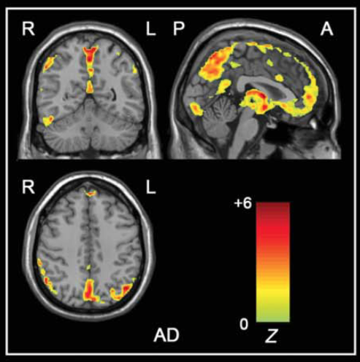
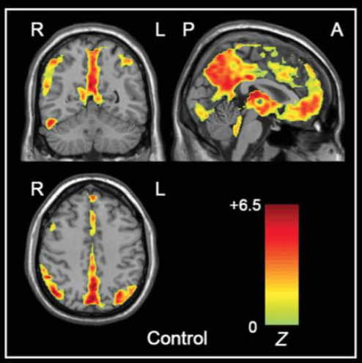
One-Sample T-Test
Wang#, Yan# et al., 2011, Hum Brain Mapp

Slide 6
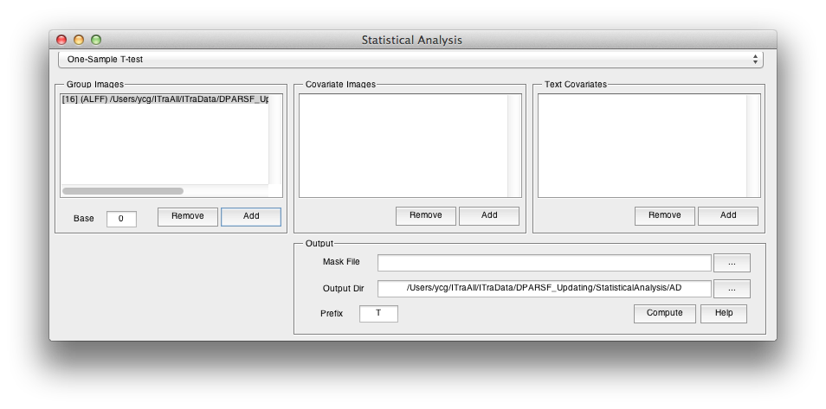
One-Sample T-Test
0 for z* images
1 for m* images
T Statistic Image
Group Mask

Slide 7
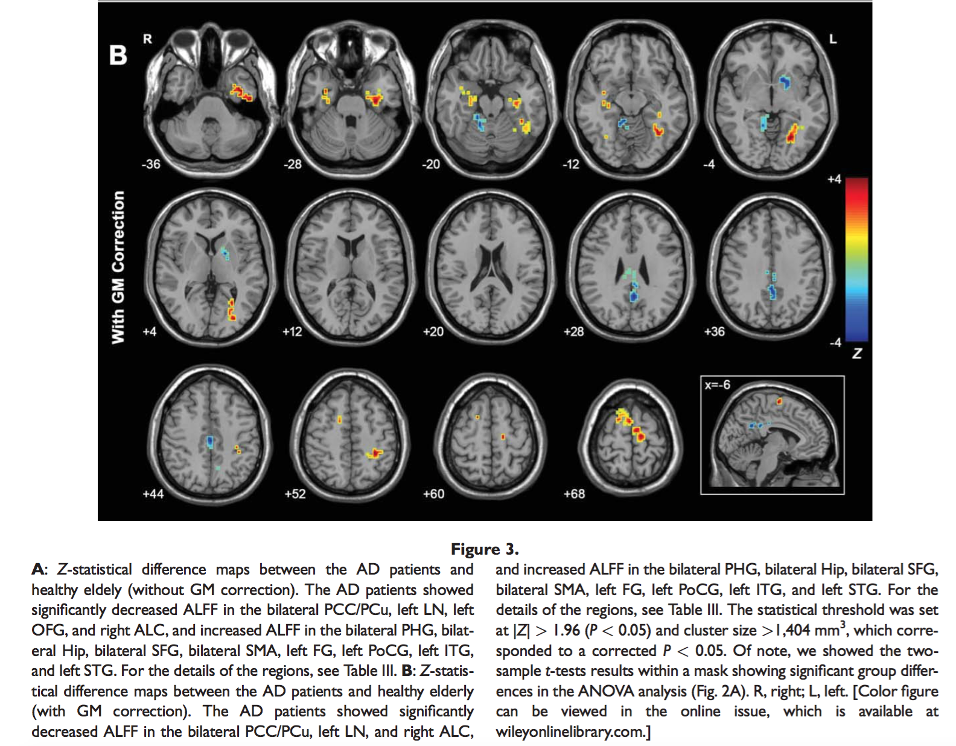
Two-Sample T-Test
Wang#, Yan# et al., 2011, Hum Brain Mapp

Slide 8
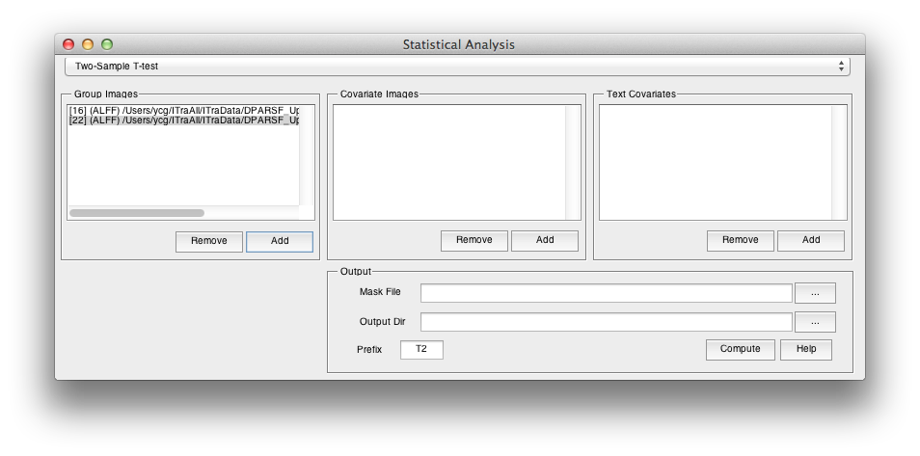
Two-Sample T-Test
T Statistic Image: positive corresponds to the mean of Group 1 is greater than the mean of Group 2

Slide 9
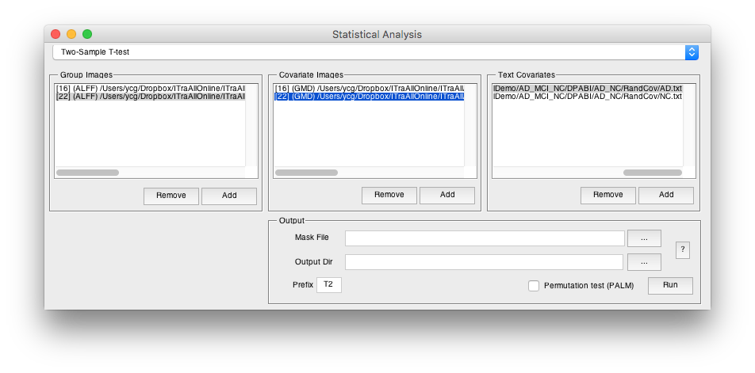

Two-Sample T-Test
Two-Sample T-Test with covariates: e.g. gray matter proportion images (Oakes et al., 2007, Neuroimage)
Please make sure the correspondence between the group images and the covariate images: order and voxel size
Other covariate can be also specified as text files. (E.g. head motion (mean FD), age, sex etc.)

Slide 10
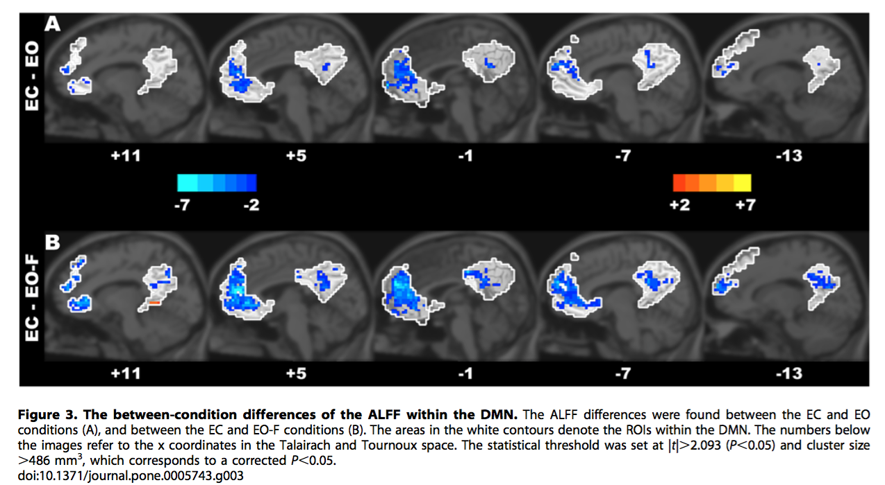
Paired T-Test
Yan et al., 2009. PLoS ONE

Slide 11

Paired T-Test
T Statistic Image
Condition 1 – Condition 2
Please make sure the correspondence

Slide 12
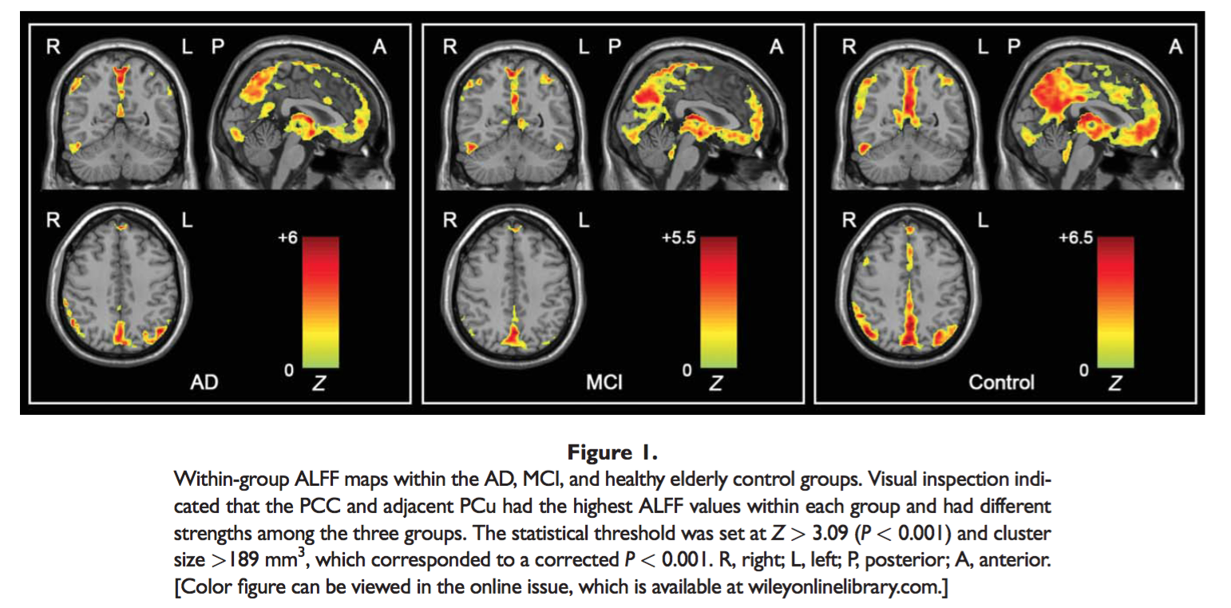
ANOVA or ANCOVA
Wang#, Yan# et al., 2011, Hum Brain Mapp

Slide 13
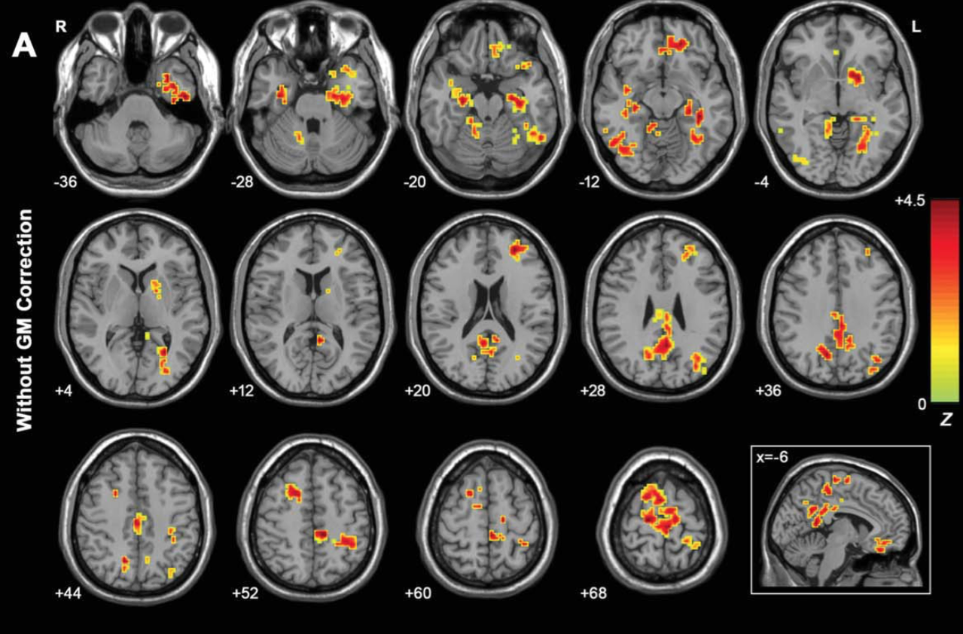
ANOVA or ANCOVA
Wang#, Yan# et al., 2011, Hum Brain Mapp

Slide 14
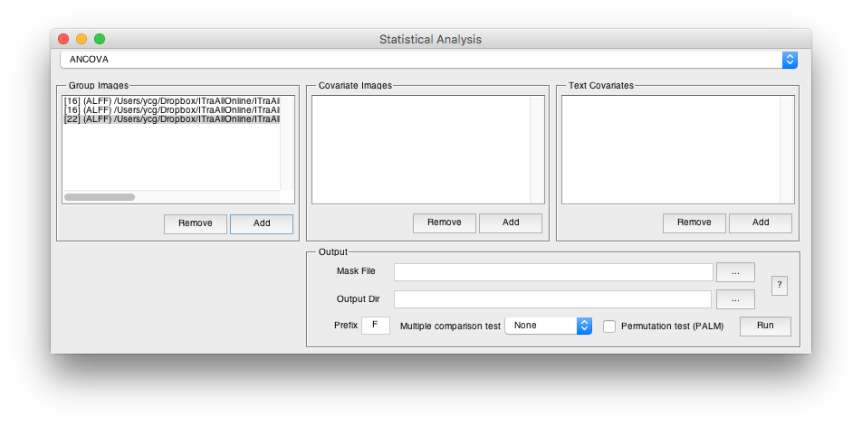
ANOVA or ANCOVA
ANCOVA: e.g. gray matter proportion images (Oakes et al., 2007, Neuroimage)
F Statistic Image
Please make sure the correspondence between the group images and the covariate images: order and voxel size
Other covariate can be also specified as text files. (E.g. age, brain size, IQ etc.)

Slide 15
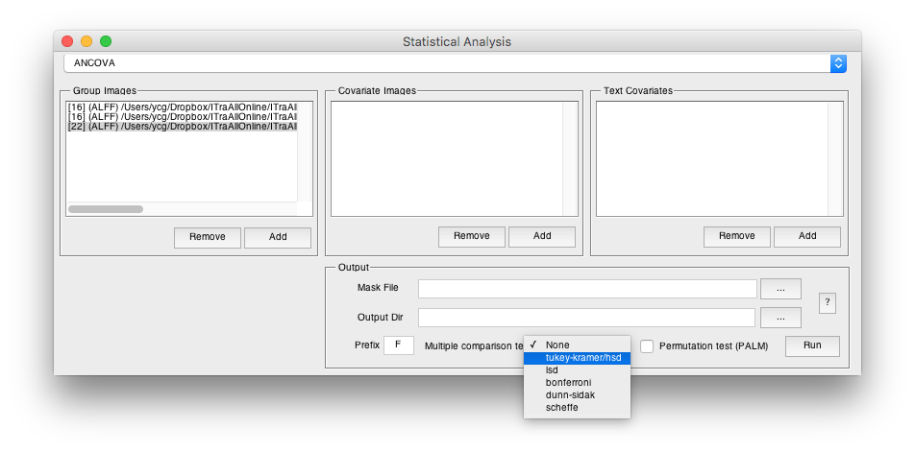
ANOVA or ANCOVA
Post-hoc procedures: the corrected p values under a given control procedure for comparing group means of any pairs were calculated (e.g., through Studentized Range statistic for Tukey-Kramer correction) with the same route as MATLAB command multcompare. The p maps were then converted to Z maps according to the Normal inverse cumulative distribution function (norminv), with the sign of group mean differences applied.

Slide 16
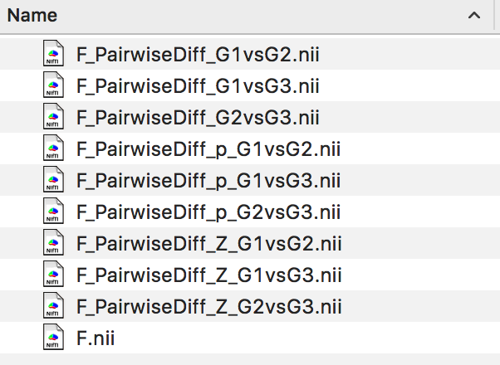
ANOVA or ANCOVA
ANOVA F image
The difference of mean between groups
The corrected p of difference between groups
The corrected Z values of difference between groups, can be forwarded to further multiple comparison correction
Yan et al., 2016. Neuroinformatics

Slide 17
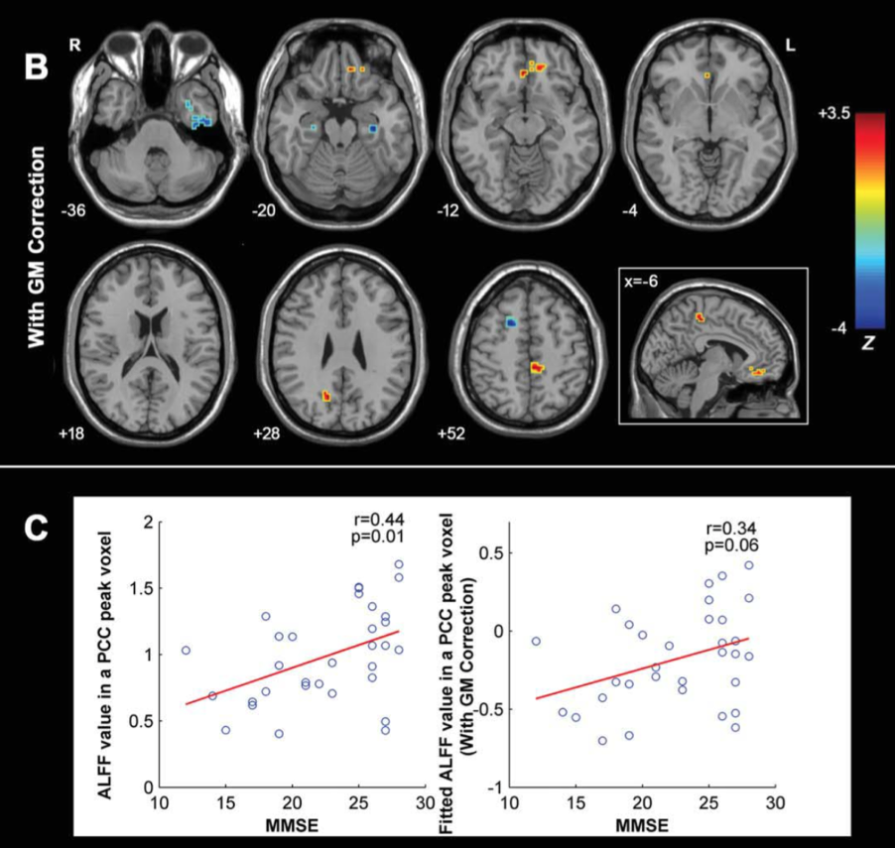
Correlation Analysis
Wang#, Yan# et al., 2011, Hum Brain Mapp

Slide 18
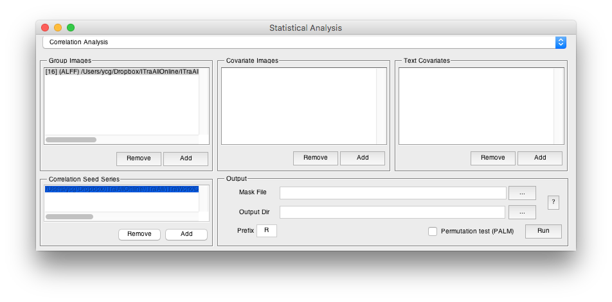
Correlation Analysis
Traits: e.g.
MMSE.txt
19
15
…
The imaging measure:
ALFF maps

Slide 19
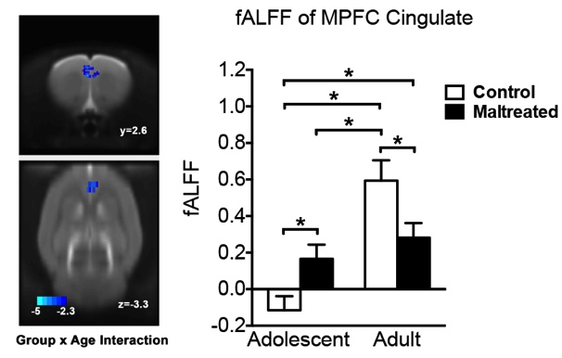
Mixed Effect Analysis
Yan et al., 2016. Translational Psychiatry

Slide 20
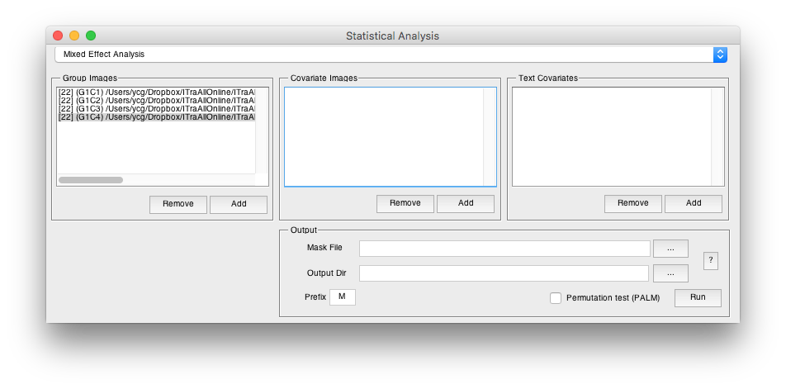
Mixed Effect Analysis
The imaging measure should be: Group1Condition1 Group1Condition2 Group2Condition1 Group2Condition2

Slide 21
Mixed Effect Analysis
*_ConditionEffect_T.nii - the T values of condition differences (corresponding to the first condition minus the second condition) (WithinSubjectFactor)
*_Interaction_F.nii - the F values of interaction (BetweenSubjectFactor by WithinSubjectFactor)
*_Group_TwoT.nii - the T values of group differences (corresponding to the first group minus the second group). Of note: the two conditions will be averaged first for each subject. (BetweenSubjectFactor)

Slide 22
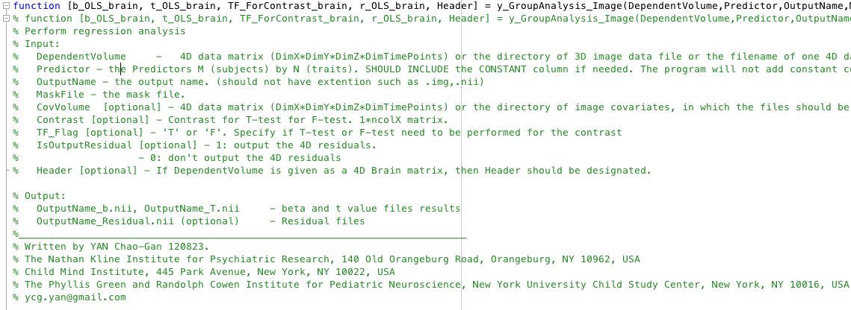
Statistical Analysis
{DPABI_Dir}/StatisticalAnalysis/y_GroupAnalysis_Image.m
22

Slide 23

Attention!!!
23

Slide 24
Statistical Analysis
{DPABI_Dir}/StatisticalAnalysis/y_GroupAnalysis_Image.m
Smoothness estimation based on the 4D residual is built in this function!!!
24

Slide 25
Statistical Analysis
http://rfmri.org/DemoData
{Download}/ProcessingDemoData/StatisticalDemo/AD_MCI_NC/
ALFF: AD – NC Two Sample T Test:
Applied smooth kernel in preprocessing: [4 4 4]
Smooth kernel estimated on 4D residual: [6.77 6.88 6.71]
Smooth kernel estimated on statistical image (T to Z, as in easythresh): [6.90 7.33 6.94]
ReHo: AD – NC Two Sample T Test:
Applied smooth kernel in preprocessing: [4 4 4]
Smooth kernel estimated on 4D residual: [8.10 8.50 7.93]
Smooth kernel estimated on statistical image (T to Z, as in easythresh): [8.33 8.94 8.24]
Thus, only using smooth kernel applied in preprocessing is NOT sufficient!!!
25

Slide 26
Statistical Analysis
26

Slide 27
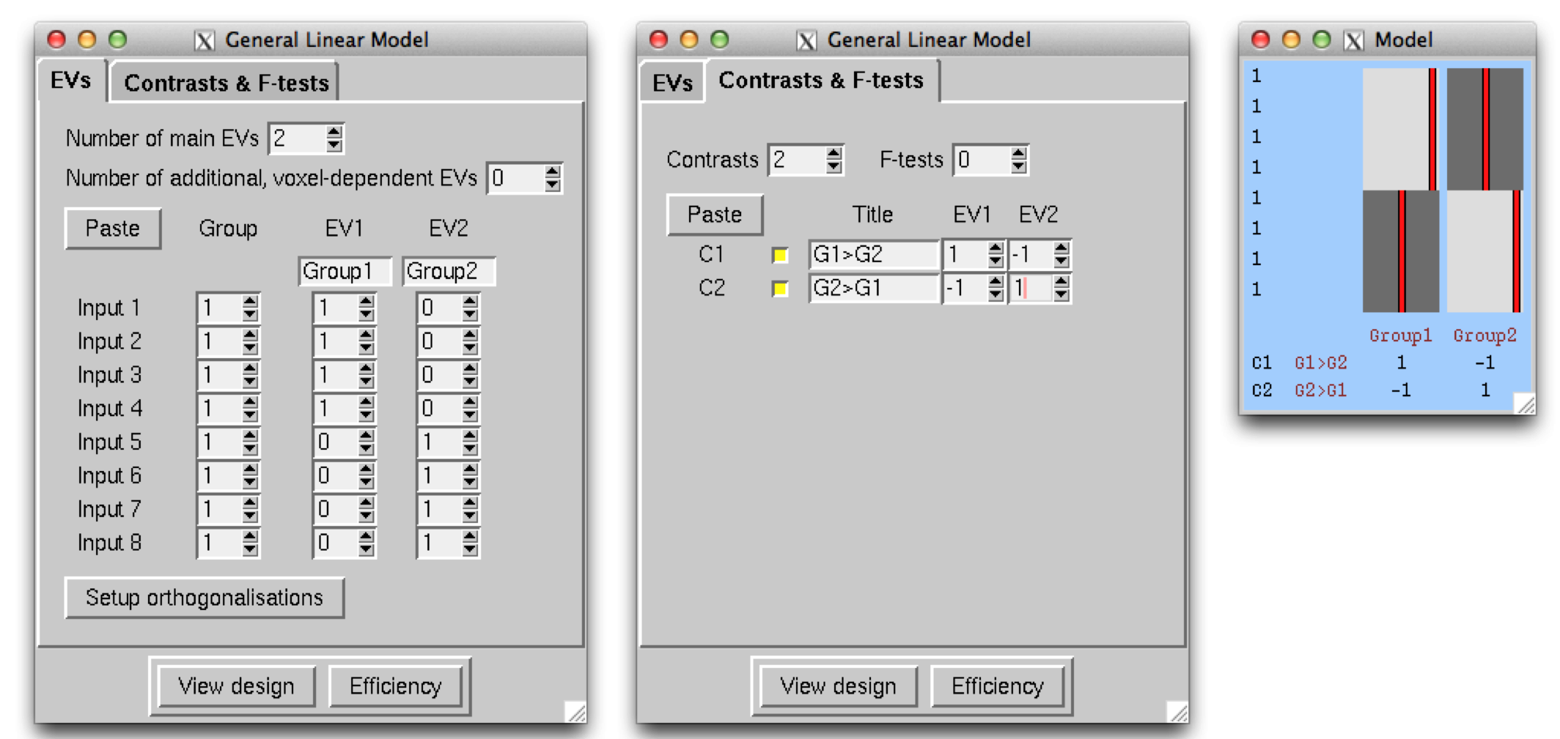
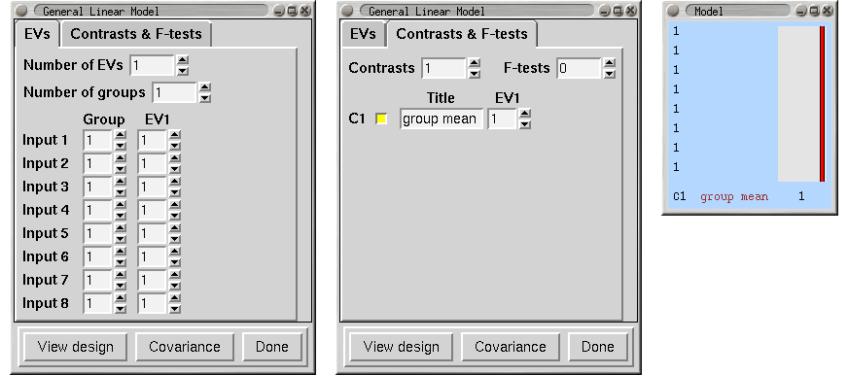
Statistical Analysis
http://fsl.fmrib.ox.ac.uk/fsl/fslwiki/GLM
27

Slide 28
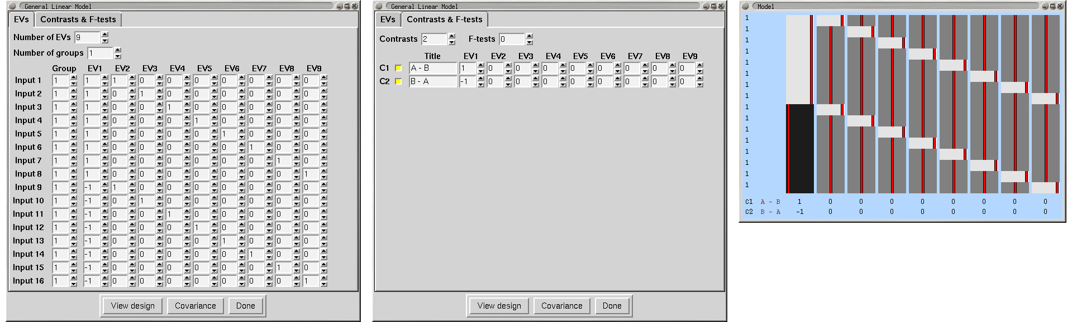
Statistical Analysis
http://fsl.fmrib.ox.ac.uk/fsl/fslwiki/GLM
28

Slide 29
Multiple Comparison Correction
29

Slide 30

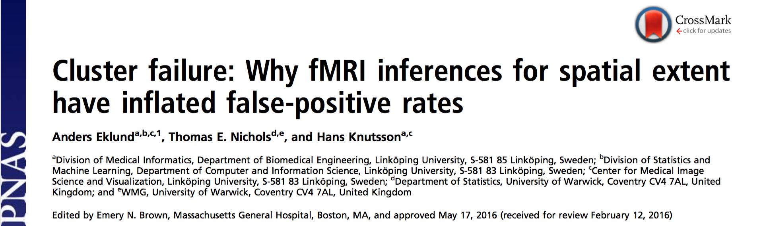
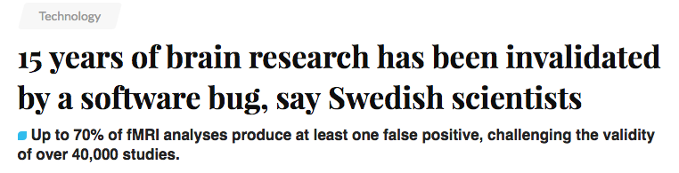
Multiple Comparison Correction
Eklund et al., 2016. PNAS
30
Notes:
Two Subjects
C: Scrubbed - unscrubbed

Slide 31
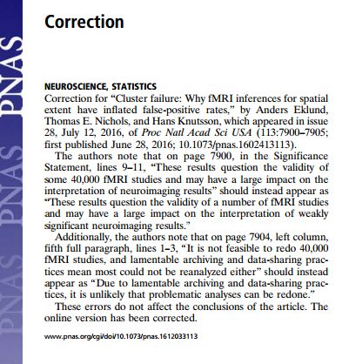
Multiple Comparison Correction
July 12, 2016
… I estimate about 15,000 papers use cluster size inference with correction for multiple testing; of these, around 3,500 use a CDT of P=0.01…So, are we saying 3,500 papers are “wrong”? It depends….
-- Thomas Nichols
July 06, 2016
31

Slide 32
Multiple Comparisons
P=0.05
Probability of not getting a false positive result:
1 - 0.05 = 0.95
P=0.05
Probability of not getting a false positive result:
1 - 0.05 = 0.95
P=0.05
Probability of not getting a false positive result:
1 - 0.05 = 0.95
P=0.05
Probability of not getting a false positive result:
1 - 0.05 = 0.95
P=0.05
Probability of not getting a false positive result:
1 - 0.05 = 0.95
0.95 0.95 0.95 0.95 0.95
0.95⁵=0.774

Slide 33
  Bonferroni correction: p=0.05/5=0.01
0.01 0.01 0.01 0.01 0.01

Slide 34
Multiple Comparisons
False Discovery Rates (FDR) correction
Family-Wise Error (FWE) correction
  Bonferroni correction: 0.05/5=0.01
  Gaussian Random Field theory correction
  Monte Carlo simulations (AlphaSim)
  Threshold-Free Cluster Enhancement
  Permutation test

Slide 35
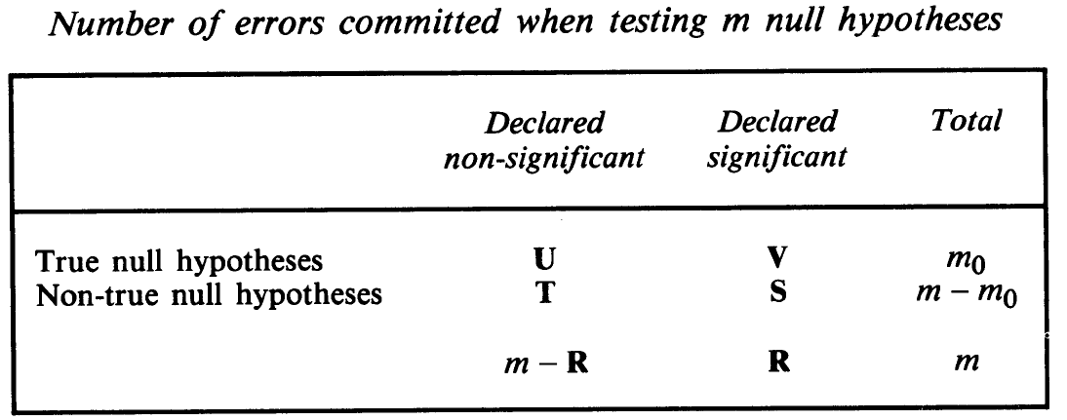
FDR Theory
False discovery rate Q_{e}=E(V/(V+S))=E(V/R)
Benjamini and Hochberg, 1995, Journal of the Royal Statistical Society
35
Notes:
35

Slide 36
FDR Theory
Let H₁, …, H_{m} be the null hypotheses and P₁, …, P_{m} their corresponding p-values. Order these values in increasing order and denote them by P₍₁₎, …, P_{(m)}. For a given q, find the largest k such that P_{(k)} ≦ kq/m.
Then reject (i.e. declare positive) all H_{(i)} for i = 1, …, k.
36
Notes:
36

Slide 37
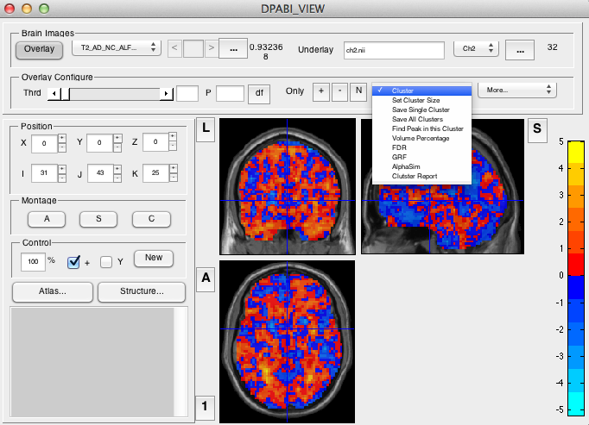
FDR in REST
37
Notes:
37

Slide 38
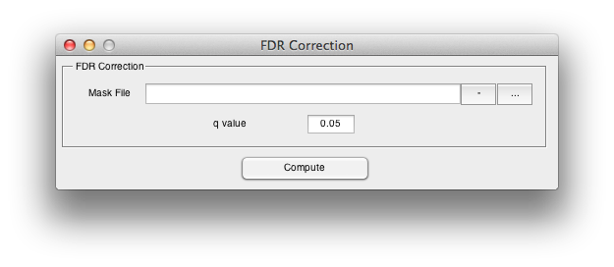
FDR
38
Notes:
38

Slide 39
Multiple Comparisons
Gaussian Random Field Theory Correction
Monte Carlo simulations (AlphaSim)
?

Slide 40
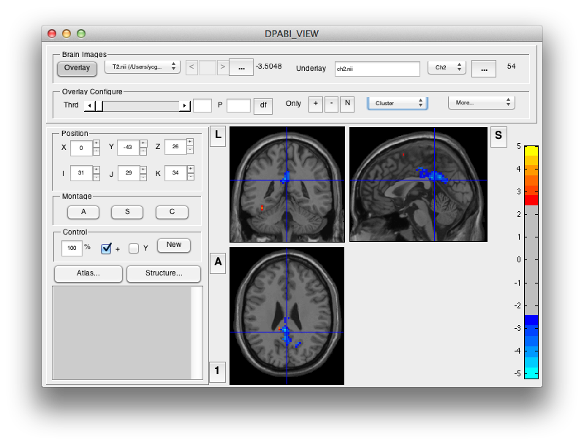

40

Slide 41
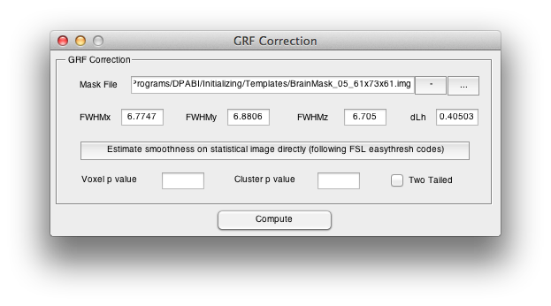
Voxel Z > 2.3, Cluster P < 0.05, Two One-Tailed Corrections:
equivalent to
Voxel P < 0.0214, Cluster P < 0.1, Two Tailed.

Slide 42
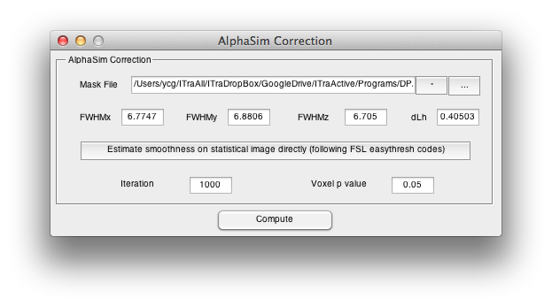

Slide 43
Cl Size Frequency Cum Prop p/Voxel Max Freq Alpha
1 235971 0.619898 0.009613 0 1.000000
2 76150 0.819945 0.006282 0 1.000000
3 32297 0.904789 0.004131 0 1.000000
4 15940 0.946664 0.002763 0 1.000000
5 8476 0.968930 0.001863 0 1.000000
6 4786 0.981503 0.001265 1 1.000000
7 2767 0.988772 0.000860 19 0.999000
8 1606 0.992991 0.000586 51 0.980000
9 1011 0.995647 0.000405 127 0.929000
10 585 0.997184 0.000276 132 0.802000
11 391 0.998211 0.000194 172 0.670000
12 236 0.998831 0.000133 146 0.498000
13 164 0.999262 0.000093 107 0.352000
14 98 0.999519 0.000063 78 0.245000
15 69 0.999701 0.000043 61 0.167000
16 37 0.999798 0.000029 30 0.106000
17 22 0.999856 0.000020 22 0.076000
18 22 0.999913 0.000015 21 0.054000
19 11 0.999942 0.000010 11 0.033000
20 7 0.999961 0.000007 7 0.022000
21 5 0.999974 0.000005 5 0.015000
22 5 0.999987 0.000003 5 0.010000
23 4 0.999997 0.000002 4 0.005000
24 1 1.000000 0.000000 1 0.001000

Slide 44
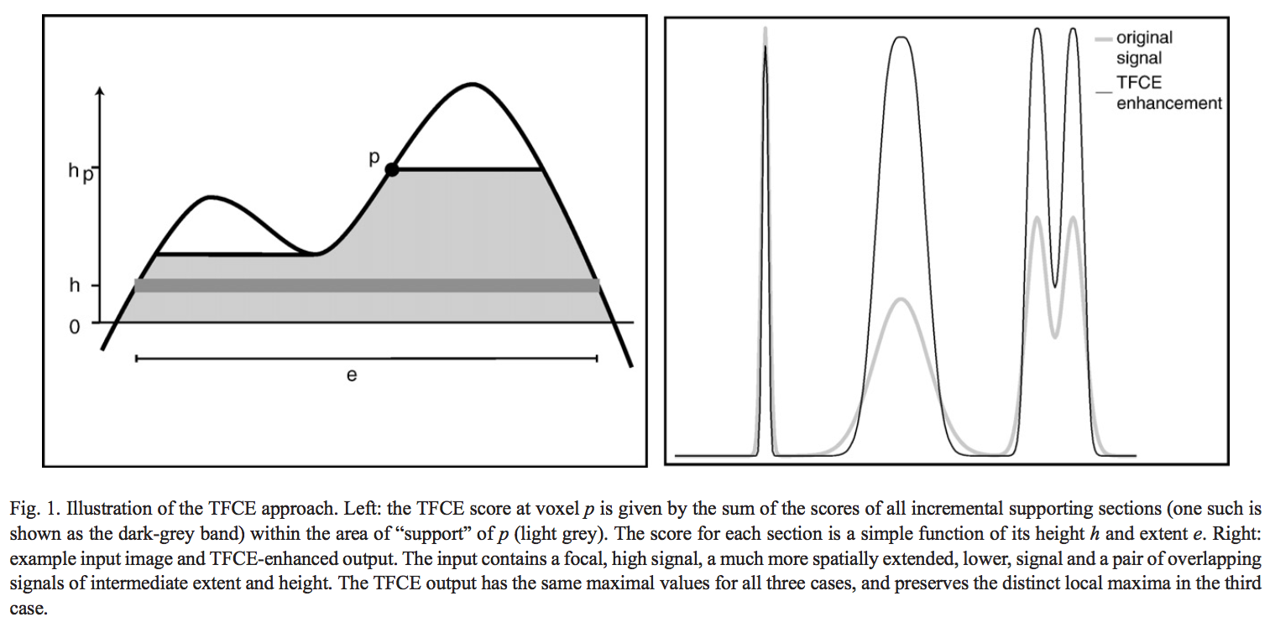
Threshold-Free Cluster Enhancement (TFCE)
Smith et al., 2009. Neuroimage
44
Notes:
Two Subjects
C: Scrubbed - unscrubbed

Slide 45
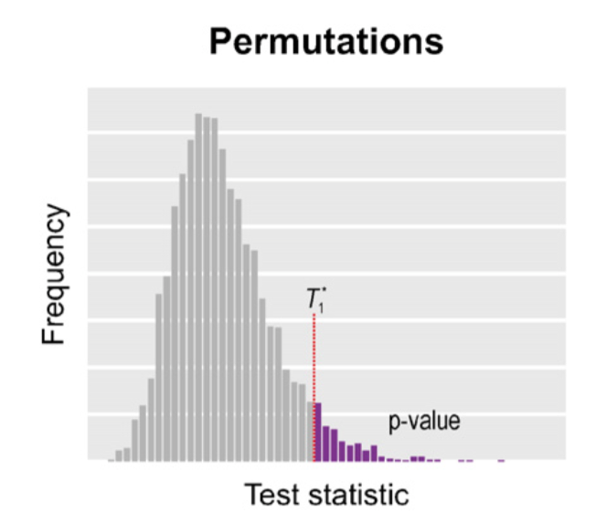
Permutation Test
Winkler et al., 2016. Neuroimage
45
Notes:
Two Subjects
C: Scrubbed - unscrubbed

Slide 46
Multiple Comparison Correction
Eklund et al., 2016. PNAS
46
Notes:
Two Subjects
C: Scrubbed - unscrubbed

Slide 47
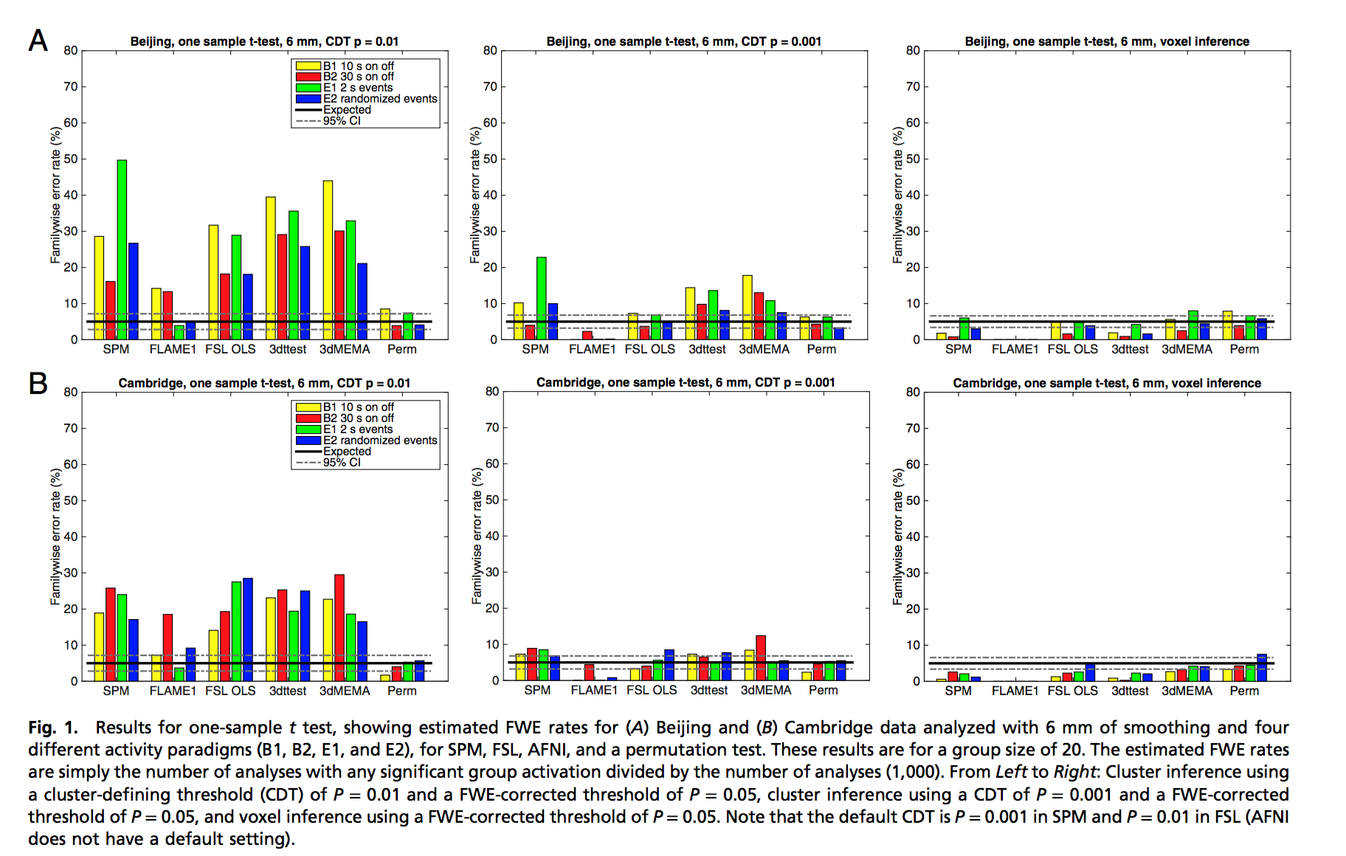
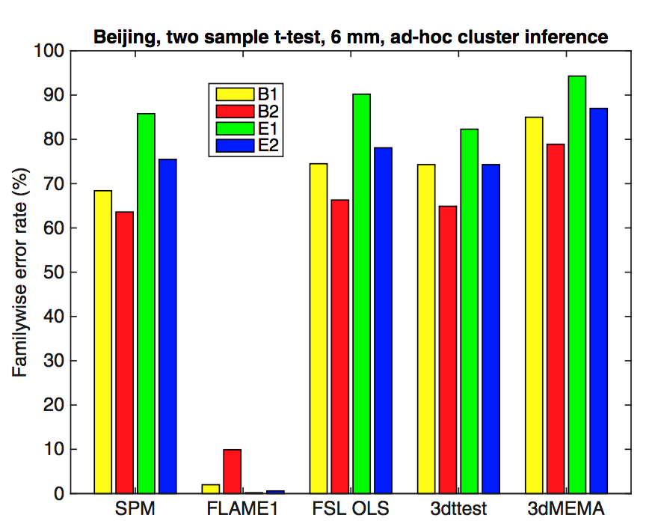
Eklund et al., 2016. PNAS
47
Notes:
Two Subjects
C: Scrubbed - unscrubbed

Slide 48
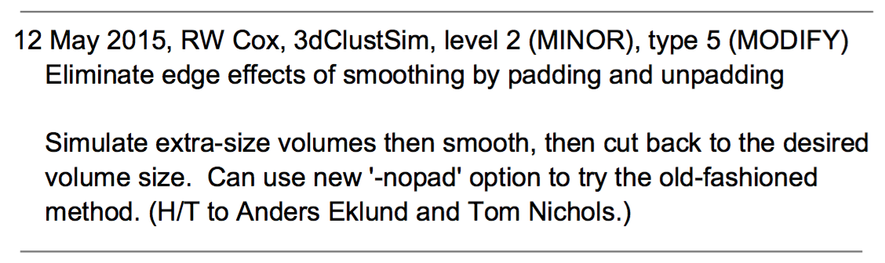
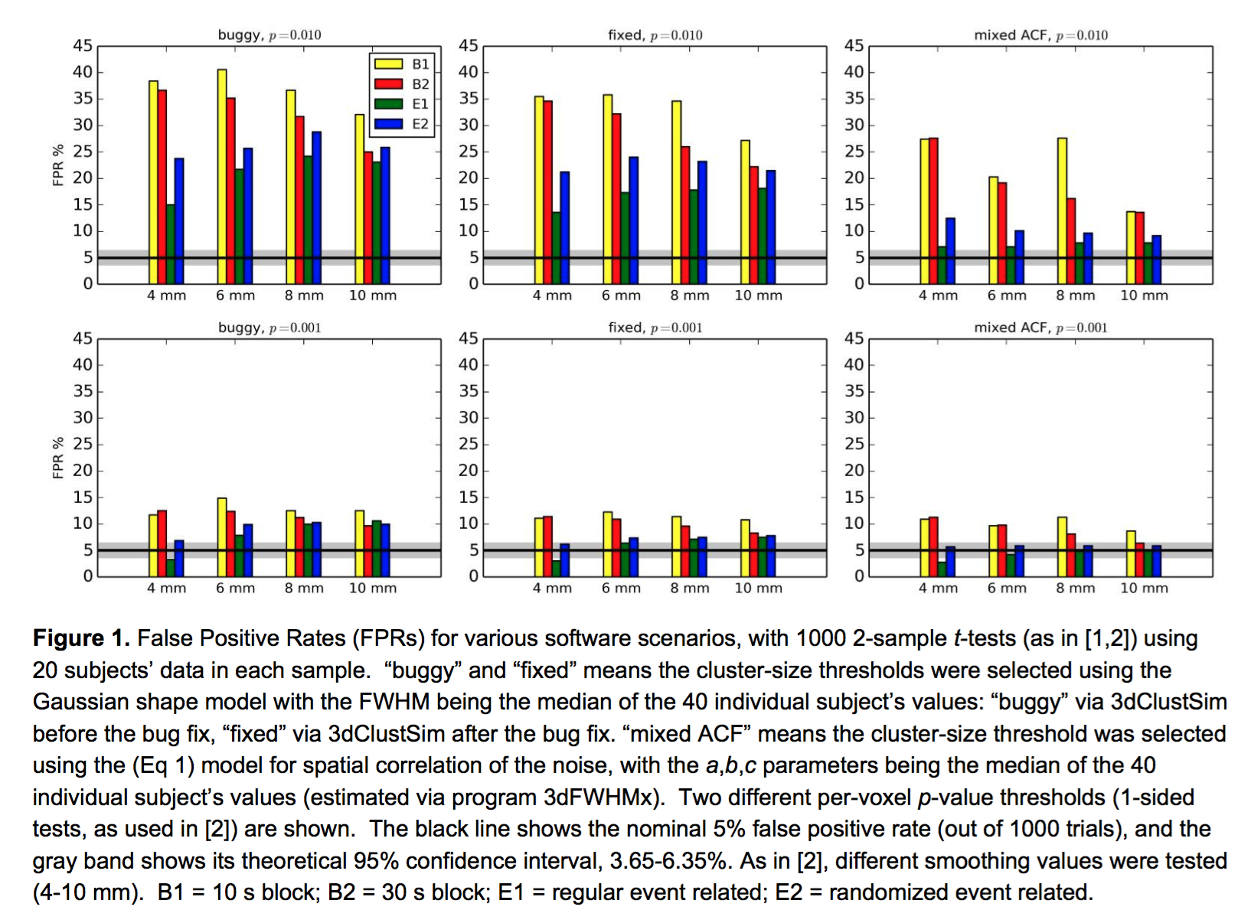
Cox et al., 2016. bioRxiv
48
Notes:
Two Subjects
C: Scrubbed - unscrubbed

Slide 49
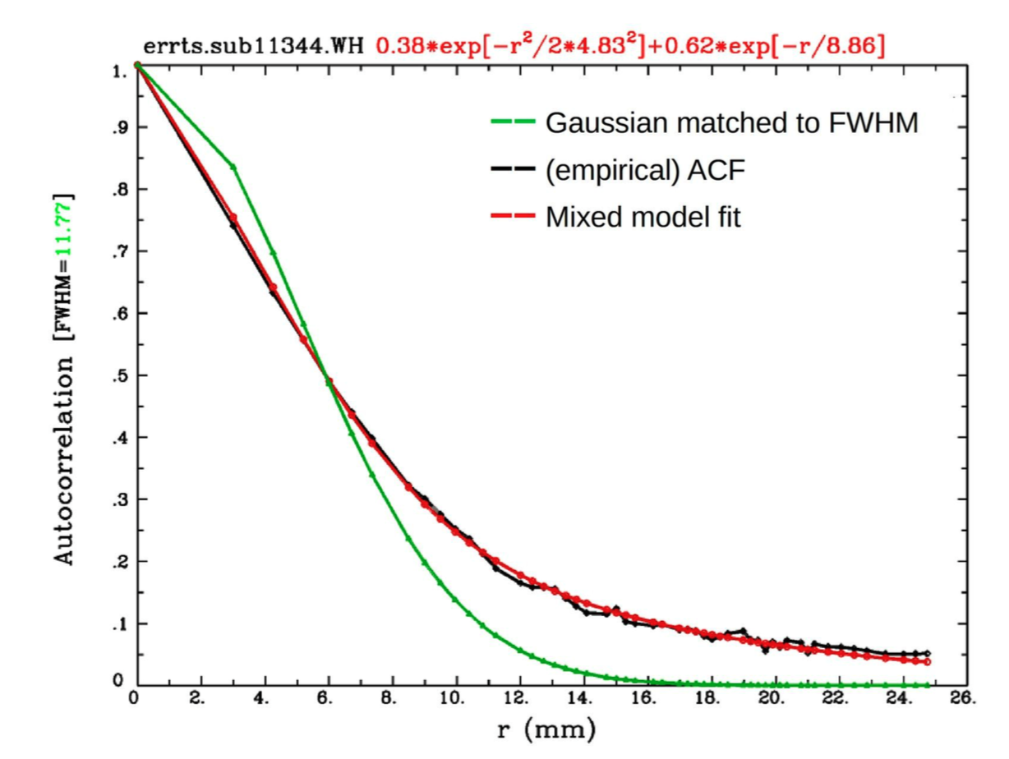
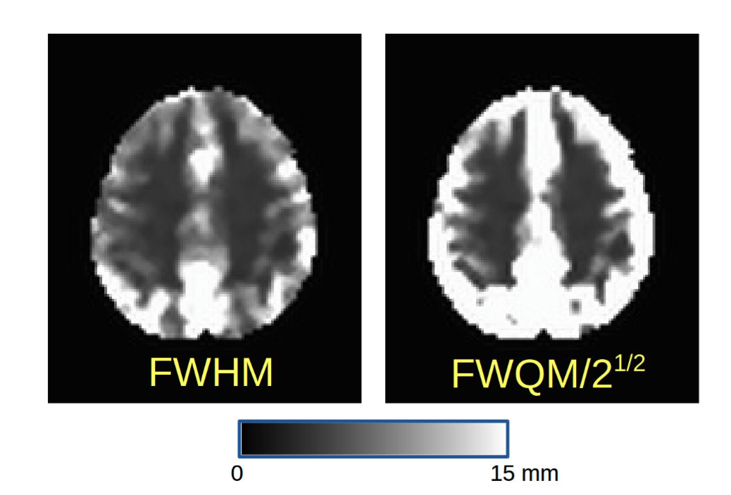
Cox et al., 2016. bioRxiv
49
Notes:
Two Subjects
C: Scrubbed - unscrubbed

Slide 50
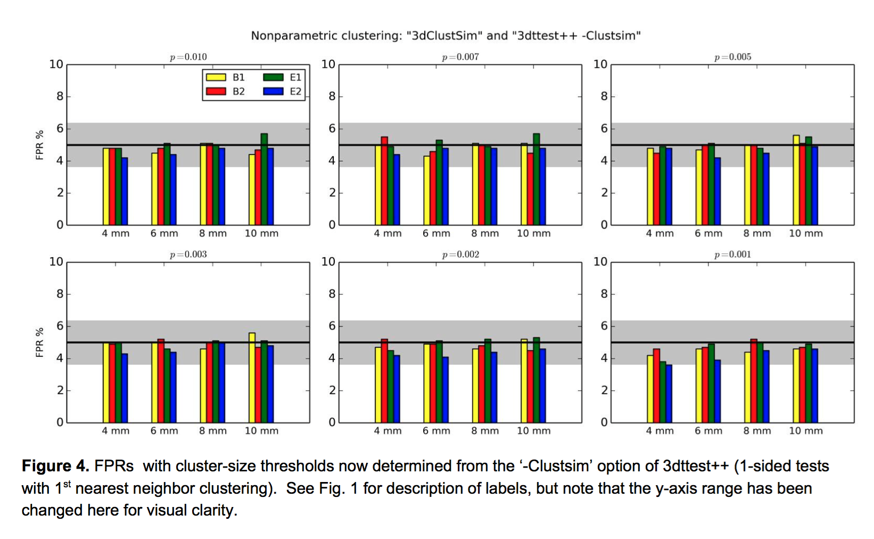
Cox et al., 2016. bioRxiv
50
Notes:
Two Subjects
C: Scrubbed - unscrubbed

Slide 51
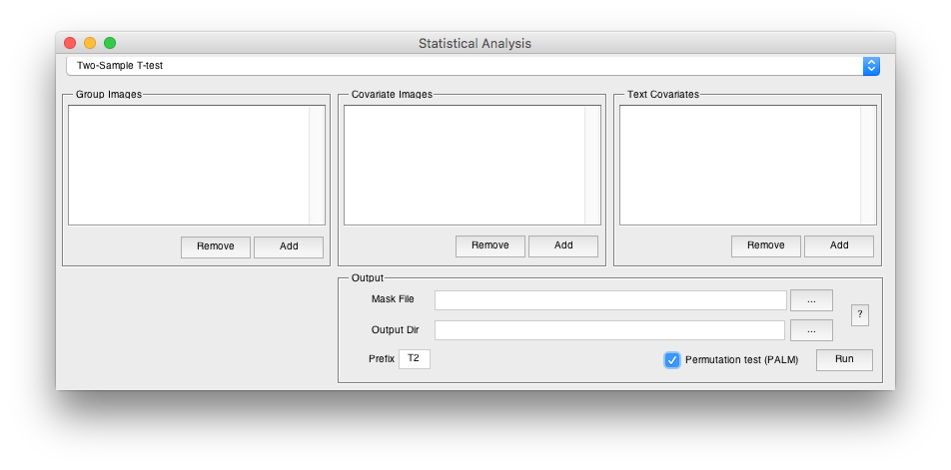
Permutation Test
51

Slide 52
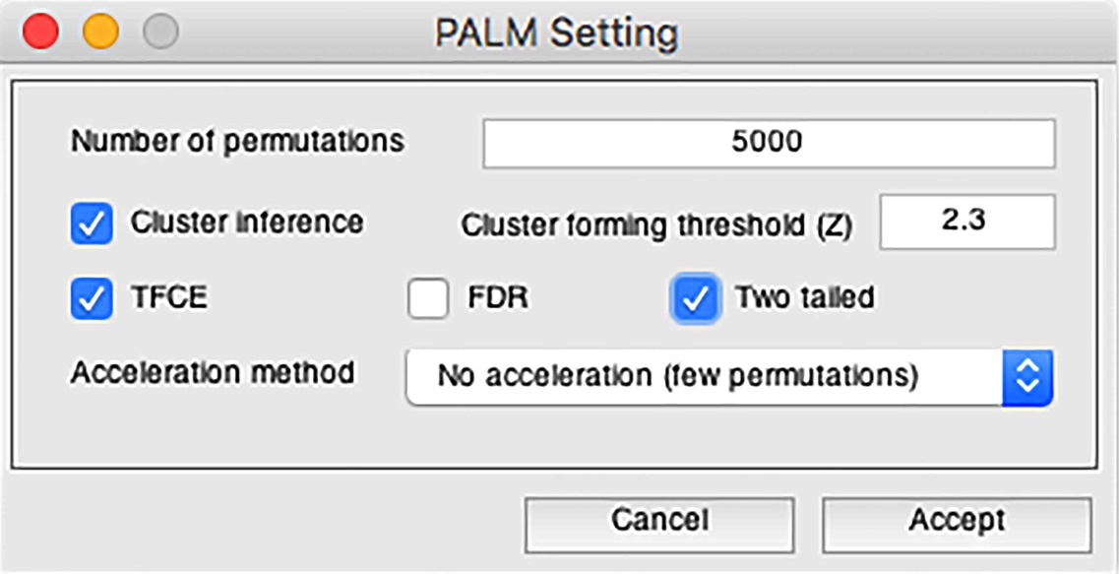
Permutation Test
Based on PALM: Winkler, A.M., Ridgway, G.R., Douaud, G., Nichols, T.E., Smith, S.M., 2016. Faster permutation inference in brain imaging. Neuroimage 141, 502-516.
52

Slide 53
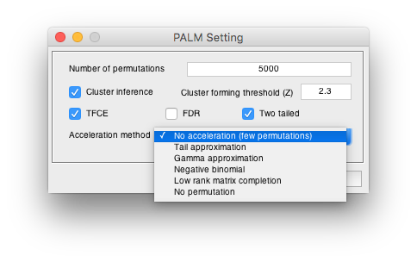
Permutation Test
Based on PALM: Winkler, A.M., Ridgway, G.R., Douaud, G., Nichols, T.E., Smith, S.M., 2016. Faster permutation inference in brain imaging. Neuroimage 141, 502-516.
53

Slide 54
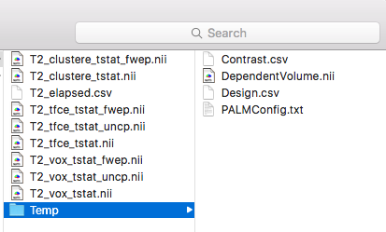
Permutation Test
Based on PALM: Winkler, A.M., Ridgway, G.R., Douaud, G., Nichols, T.E., Smith, S.M., 2016. Faster permutation inference in brain imaging. Neuroimage 141, 502-516.
54

Slide 55
Permutation Test
_vox_tstat.nii is the T value of a voxel.
_vox_tstat_uncp.nii is the p value corresponds to the rank of the observed T value within the permutations FOR A GIVEN VOXEL (the null distribution is the permuted T values of that given voxel). Computing the rank is one of the ways in which the p-value can be obtained (it's then divided by the number of permutations).
_vox_tstat_fwep.nii is the p value corresponds to the rank of the observed T value within the permutations of maximum T values across all the voxels (the null distribution is composed by the maximum T value across all the voxels for each permutation). For the corrected, the distribution of the maximum is used as reference, and the rank (or quantile) of a given voxel in relation to that distribution is used to obtain p-values.
_clustere_tstat.nii is simply the size (in voxels) of the cluster. This number acts as the test statistic.
_clustere_tstat_fwep.nii: p-values computed in the same way as 3, i.e., using the distribution of the maximum cluster size.
The TFCE maps are similar to Points 1, 2 and 3.
55

Slide 56
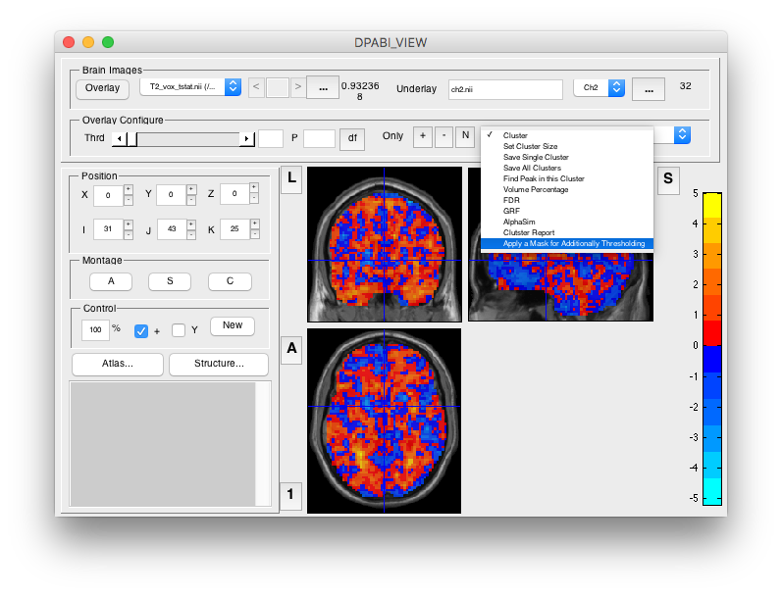
Permutation Test
56

Slide 57
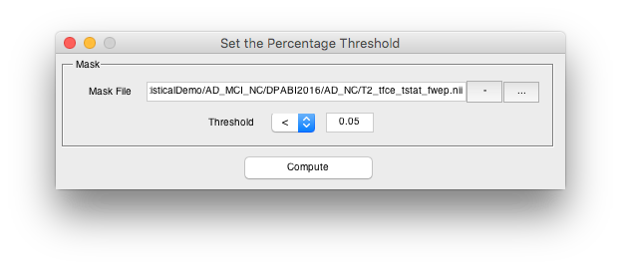
Permutation Test
57

Slide 58
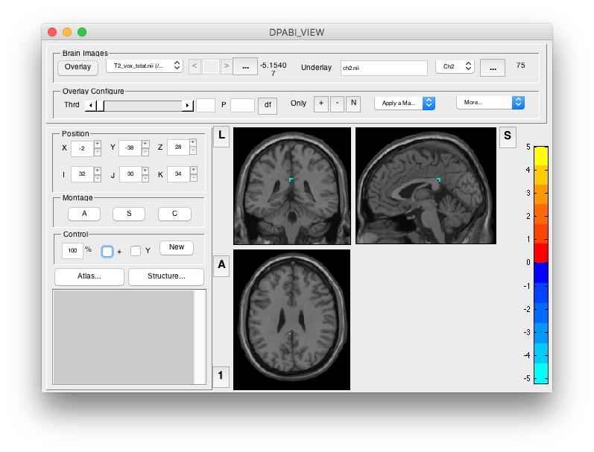
Permutation Test
58

Slide 59
Outline
Statistical Analysis
Results Viewing
59

Slide 61
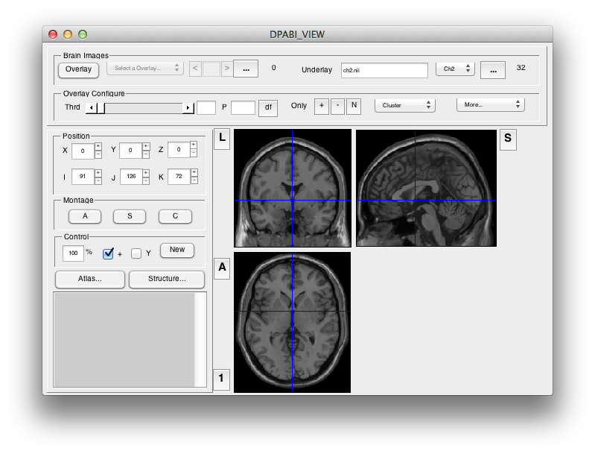

Slide 62
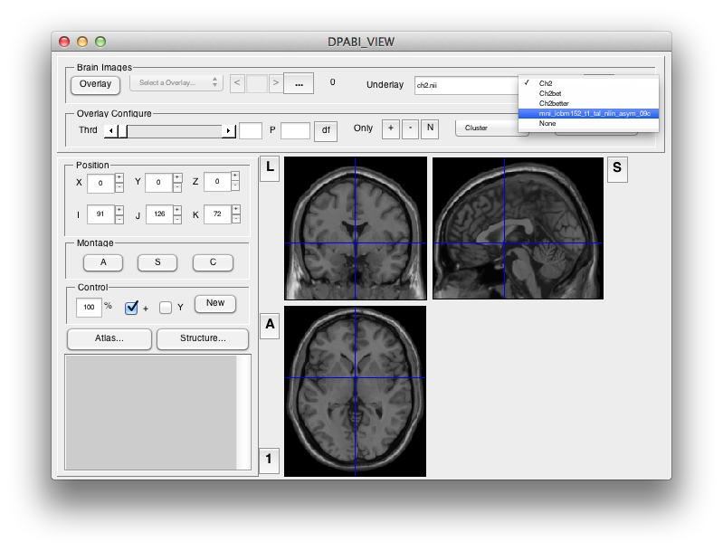
62

Slide 63
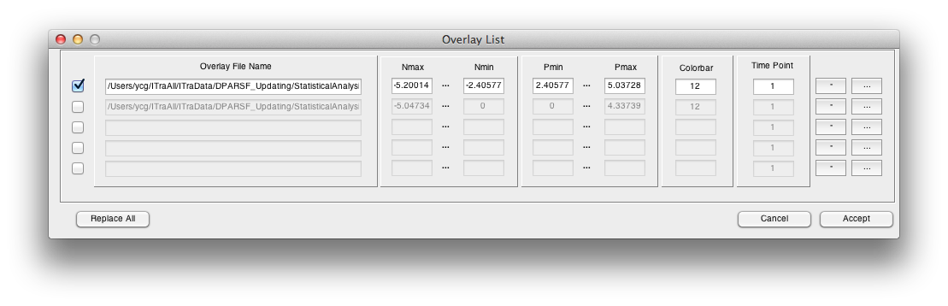

Slide 64

64

Slide 65


Slide 66
66

Slide 67
Voxel Z > 2.3, Cluster P < 0.05, Two One-Tailed Corrections:
equivalent to
Voxel P < 0.0214, Cluster P < 0.1, Two Tailed.

Slide 68


Slide 69



Slide 70

70

Slide 71

71

Slide 72
72

Slide 73

73

Slide 74

74

Slide 75

75

Slide 76




76

Slide 77

77

Slide 78
78

Slide 79

79

Slide 80

Permutation Test
80

Slide 81

81

Slide 82

82

Slide 83

Further Help
Further questions:
http://rfmri.org/dpabi
The R-fMRI Network
83

Slide 84
Acknowledgments
Chinese Academy of Sciences Xi-Nian Zuo
NYU Child Study Center
F. Xavier Castellanos
Hangzhou Normal University Yu-Feng Zang
Child Mind Institute
Michael P. Milham
Beijing Normal University
Yong He
Xin-Di Wang
Funding
National Natural Science Foundation of China
Chinese Academy of Sciences
Notes:
Different Axis!!!

Slide 85
Thanks for your attention!
85

